Slide 1
Educational Program Advisor

Slide 2



Slide 3
Problem statement
Problem: Every year school graduates face the problem of choosing a higher educational institution.
What specialty to choose?
What university to enter?
Users: School graduates and their parents, who are deciding which university to choose.
Solution: Web application that contains list of all universities with details, prof orientational tests, specialties selection algorithms.

Slide 4

User roles
Admin
Registered User
Visitor

Slide 5
Visitor functionality
View list of universities, specialties with detailed information
View TOP universities
Registration
Research

Slide 6
Registered user functionality
Create an account where personal data can be showed
Add to wish list interested specialties
Pass Professional orientation tests
Auto generation of specialty list where he can apply documents
Specialty list can be generated based on ZNO subjects, Directions, and by Districts

Slide 7
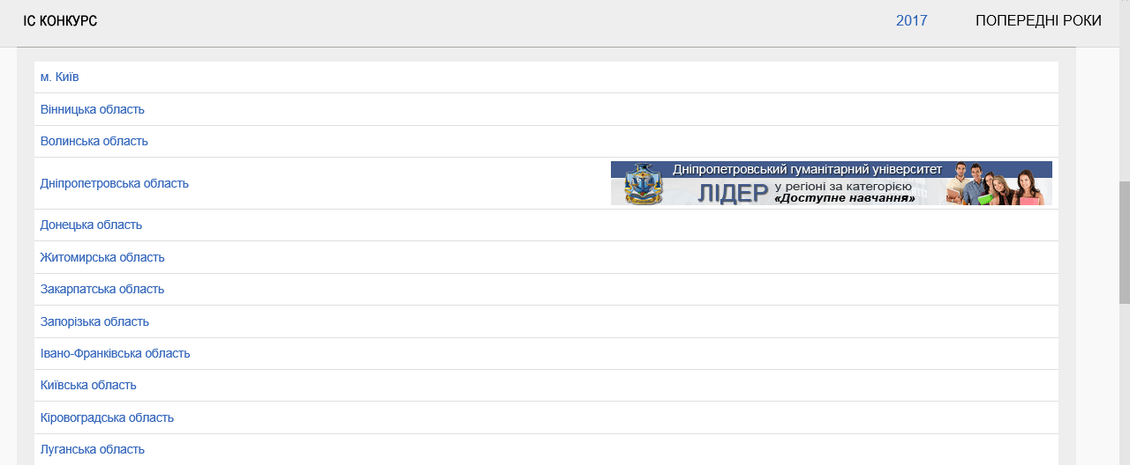
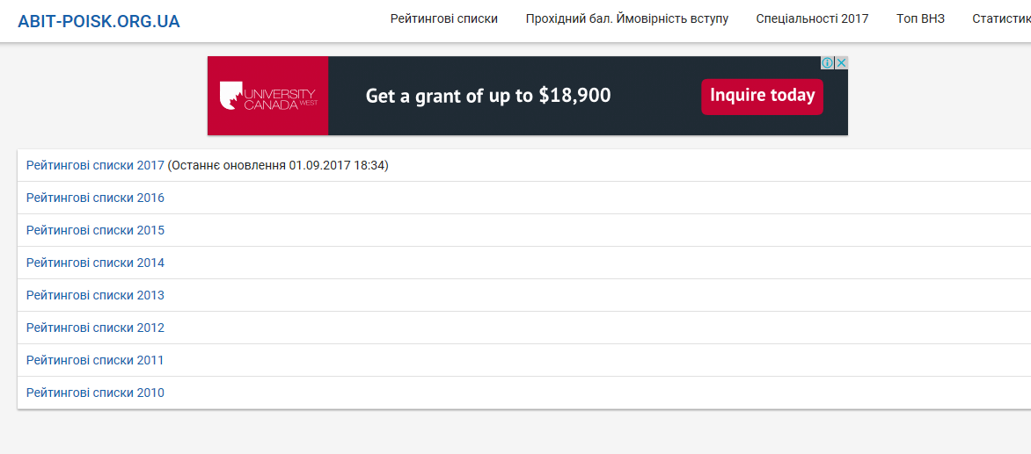
Analogues
http://www.vstup.info/
https://abit-poisk.org.ua/rate-review/

Slide 8

















Technologies we use
SCRUM

Slide 9
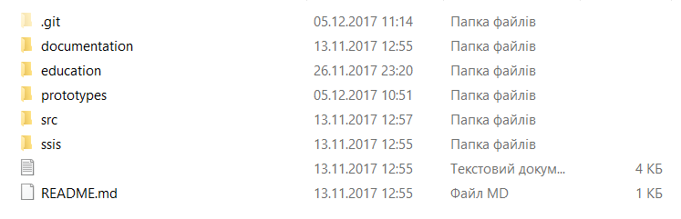
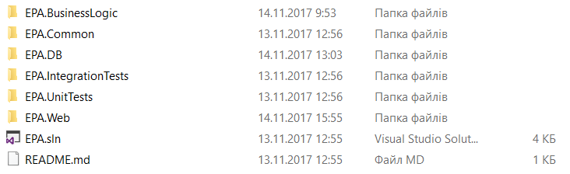
Solution architecture

Slide 10
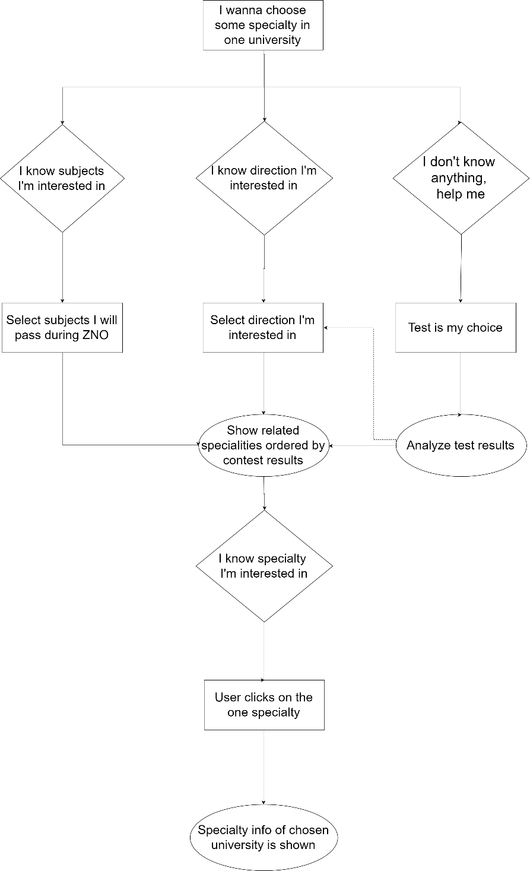
User flow

Slide 11
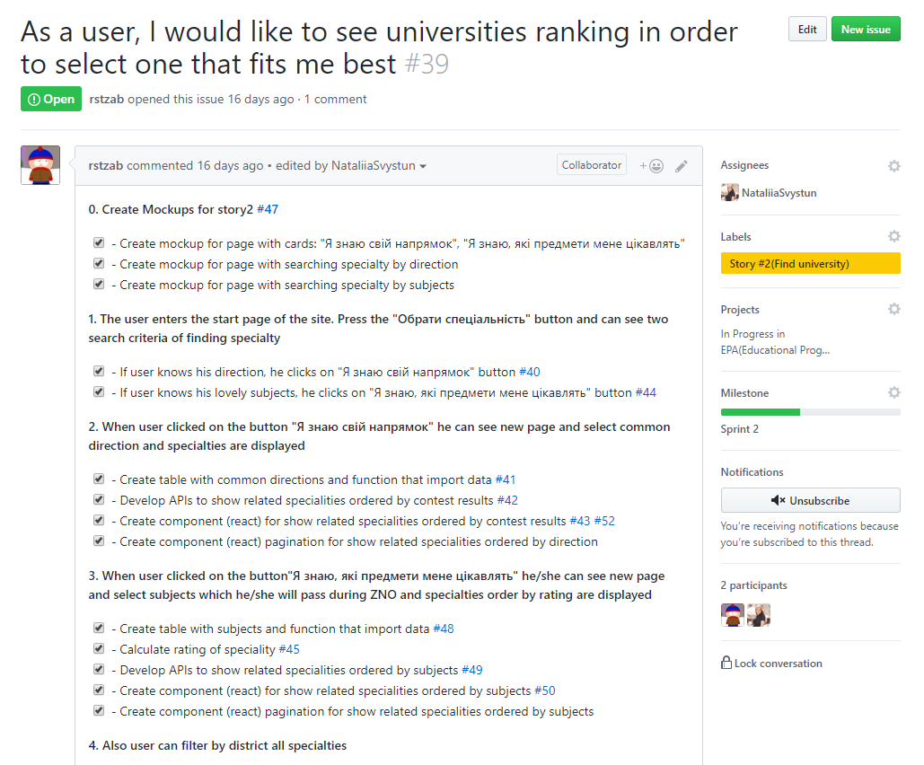
User story

Slide 12
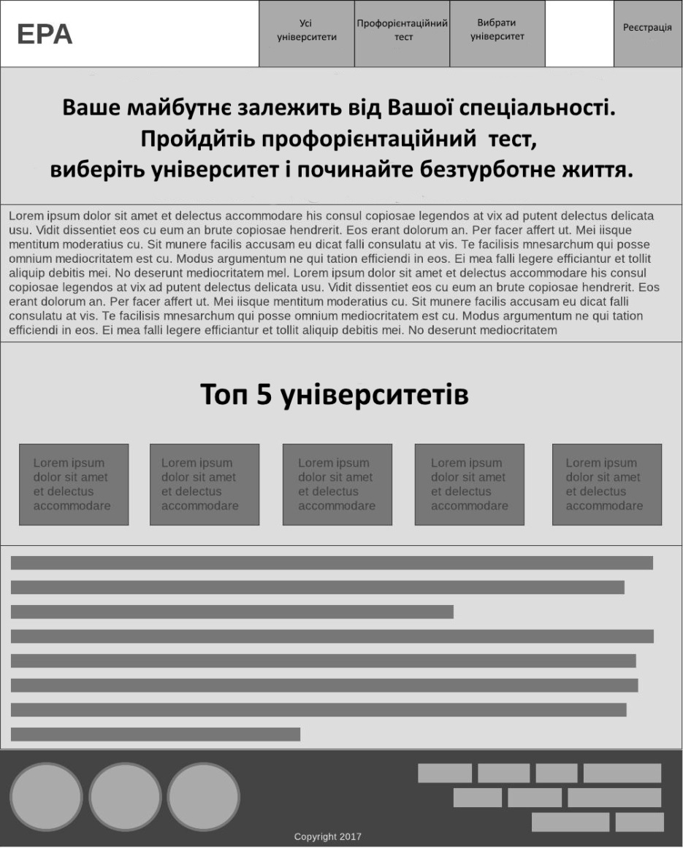
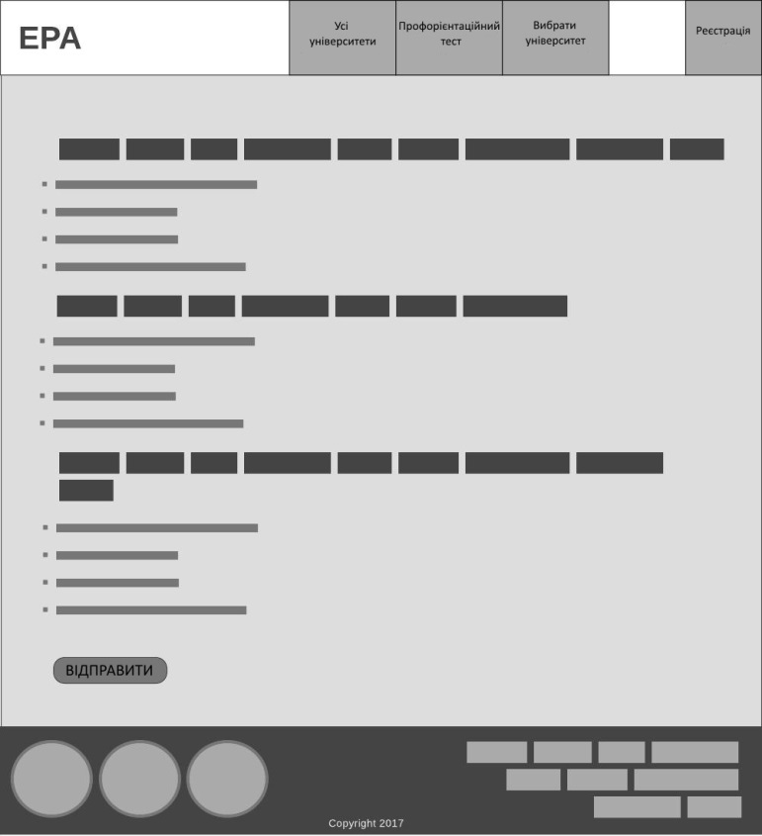
Mockup

Slide 13
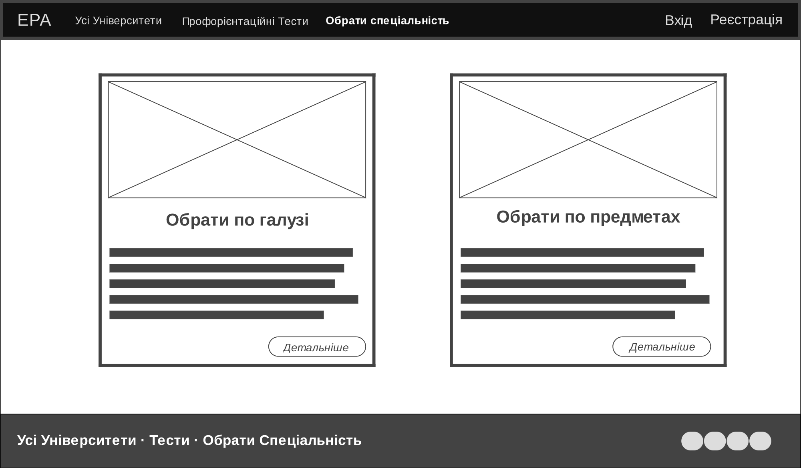
Mockup

Slide 14
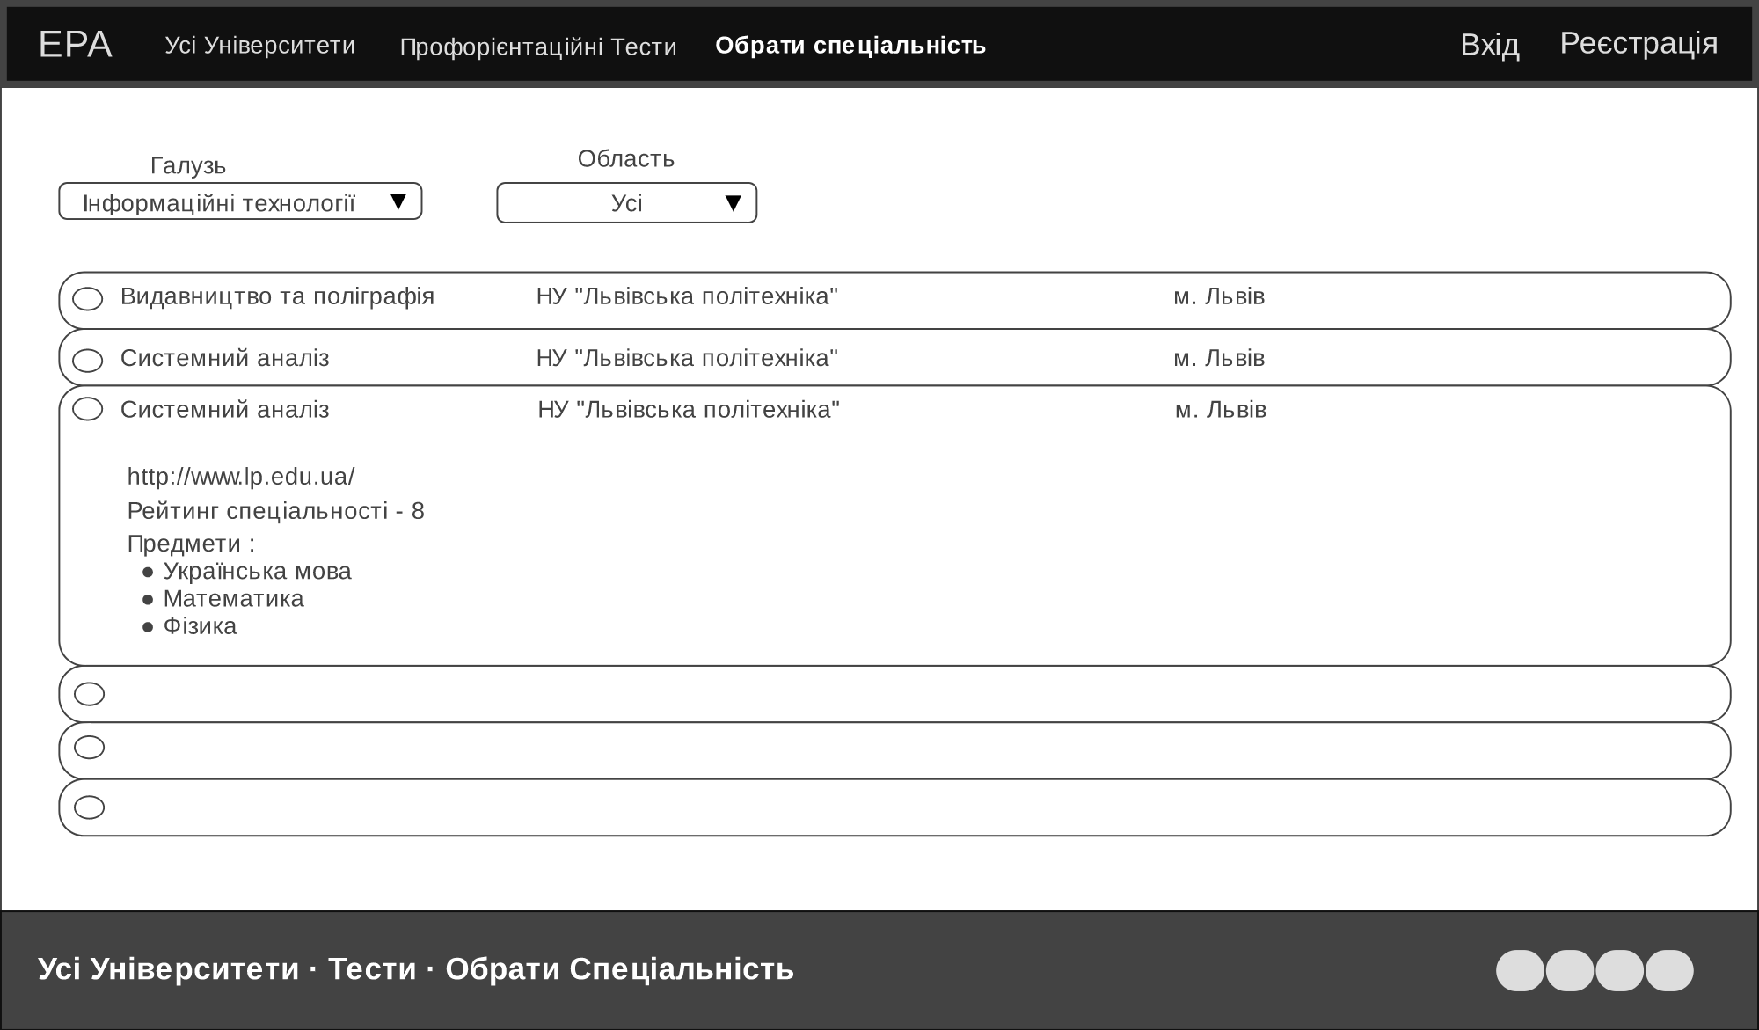
Mockup

Slide 15
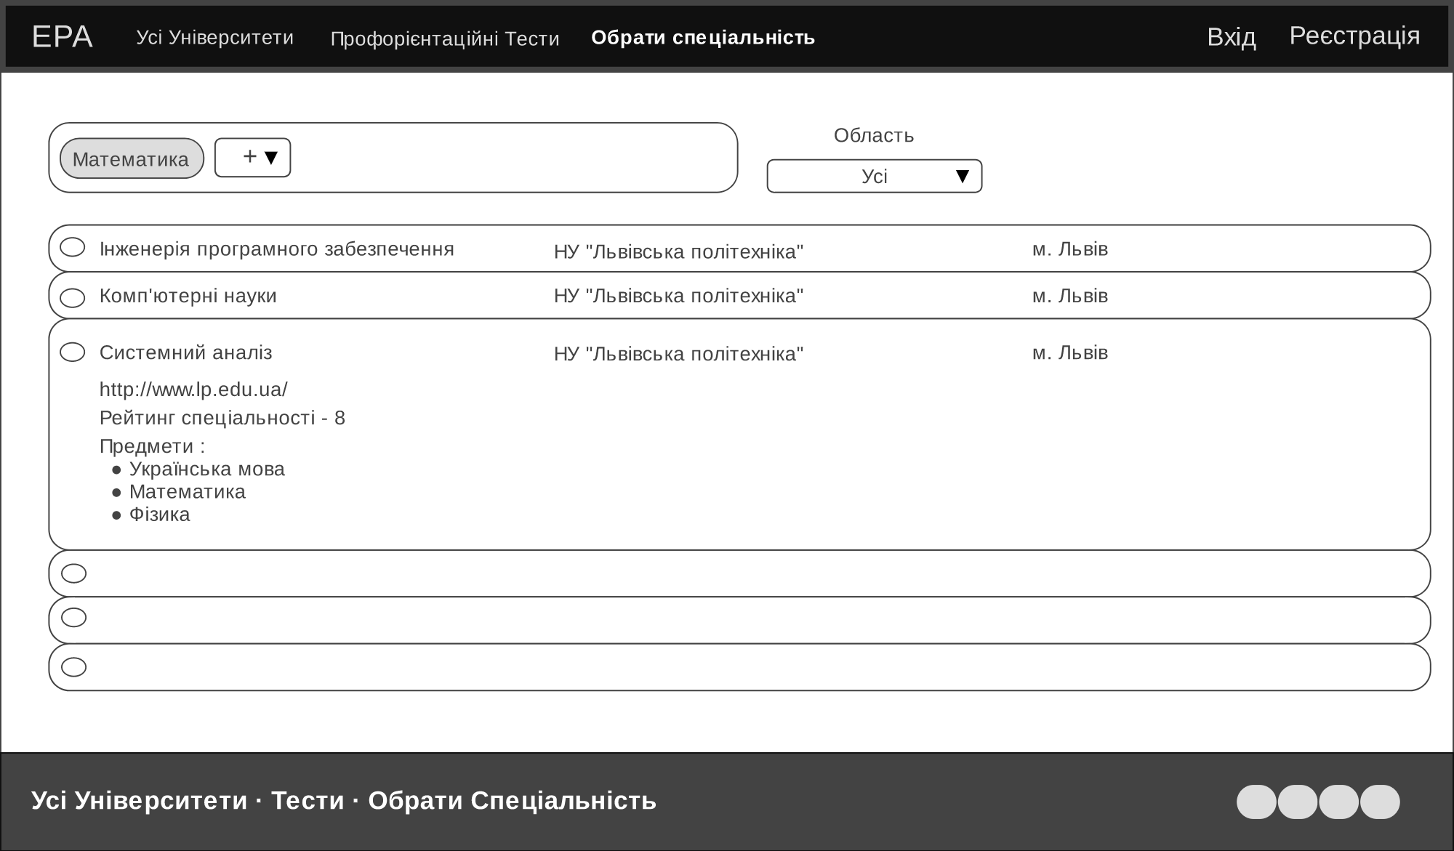
Mockup

Slide 16
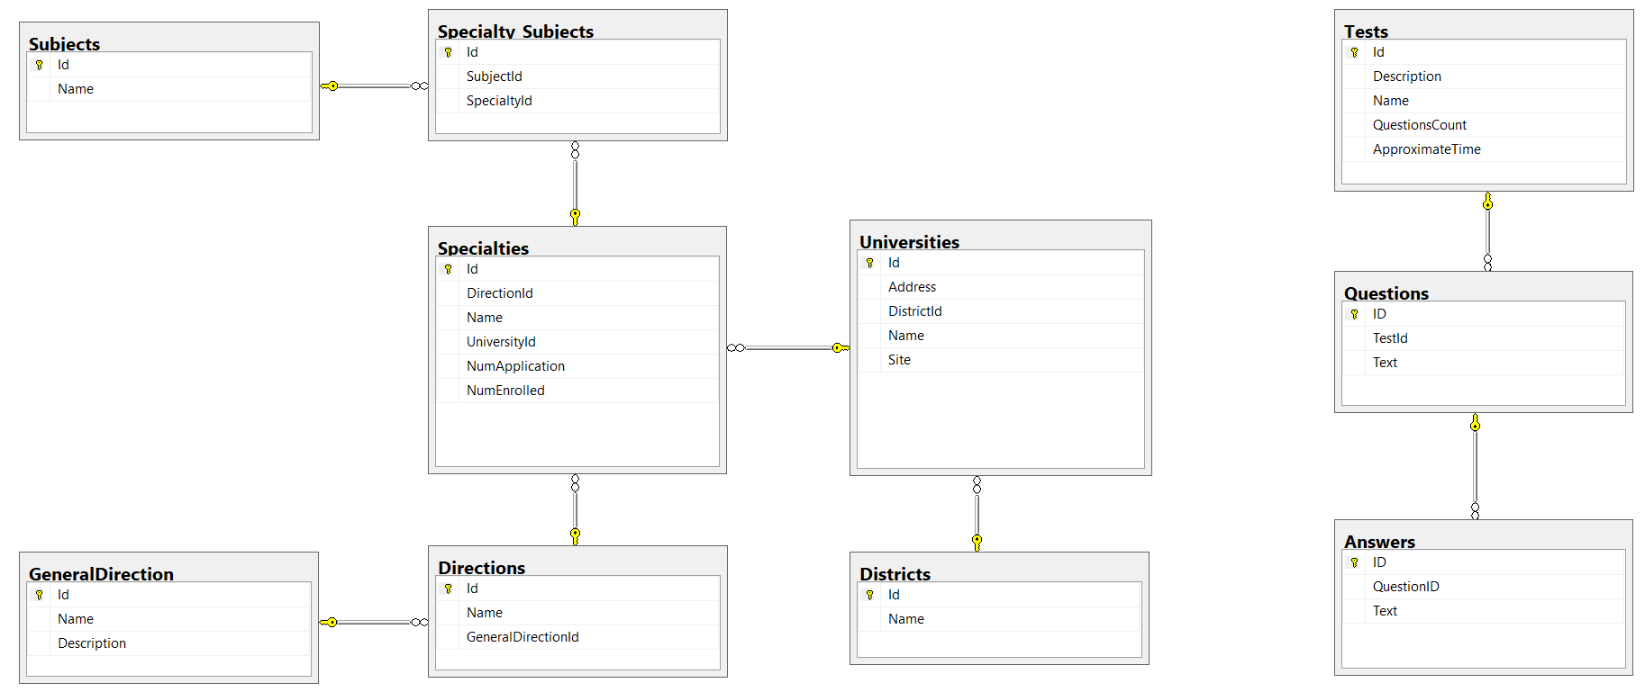
Data Base

Slide 17
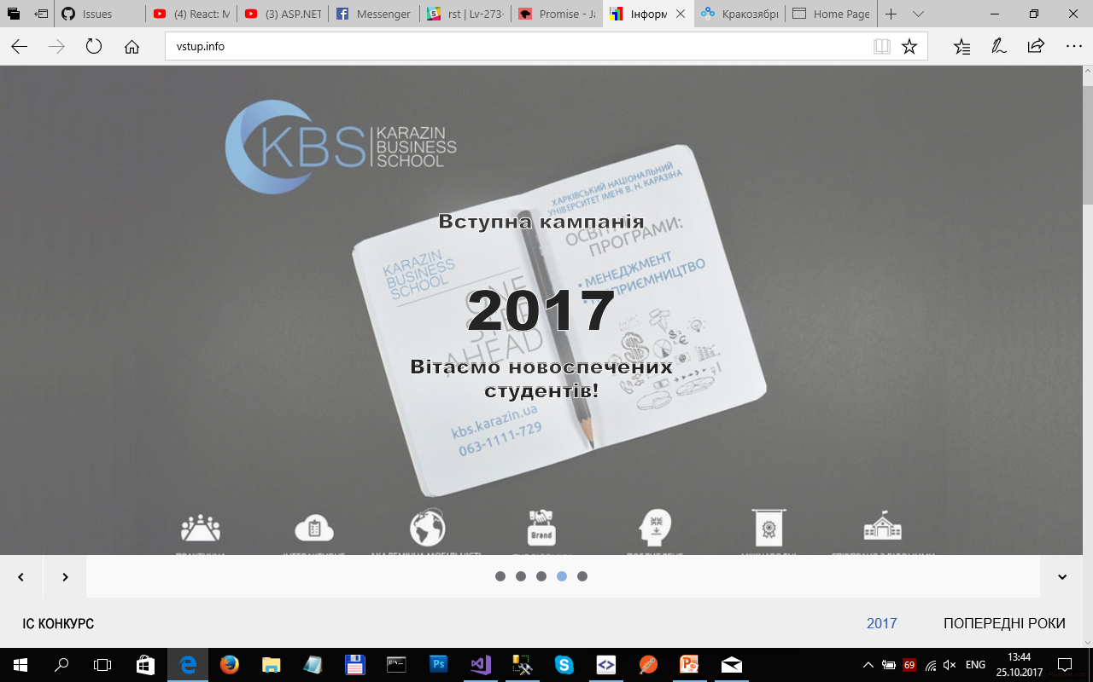

Data integration
To fill data base tables that contain information about universities and their specialties, we created additional ETL service that parses information from site “vstup.info” and it will run periodically.
MSSQL

Slide 18









TEAM TEAM TEAM

Slide 19
Top Universities
As a user I would like to see the top 5 universities on the start page:
in ETL download universities and information about them (including pictures);
to make procedures for access on DB;
to make methods on API;
to make component on UI

Slide 20
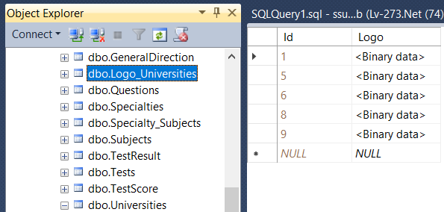
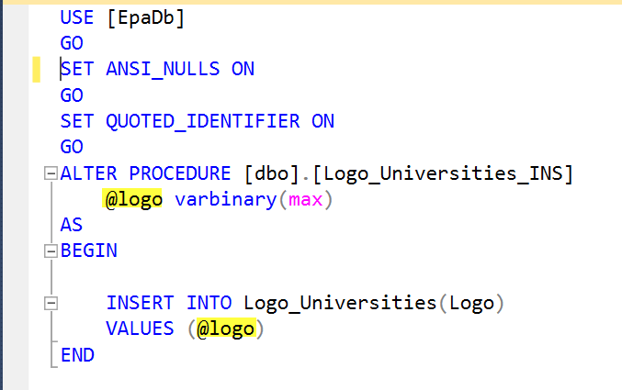
Table Logo_Universities and Stored Procedure in SQL Server 2014 Management Studio

Slide 21
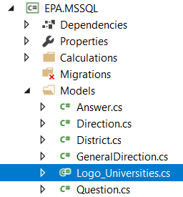
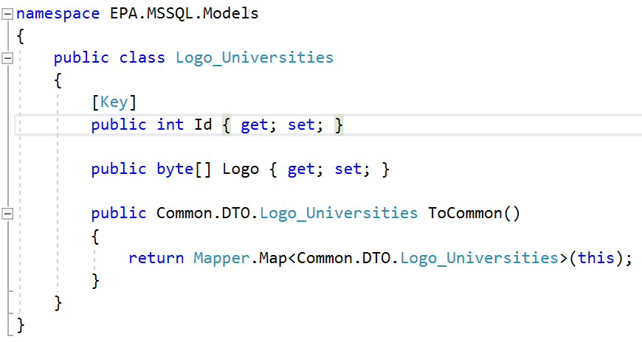
Logo_Universities Model

Slide 22
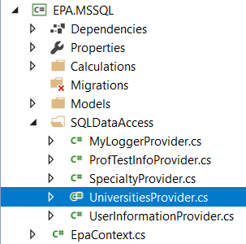
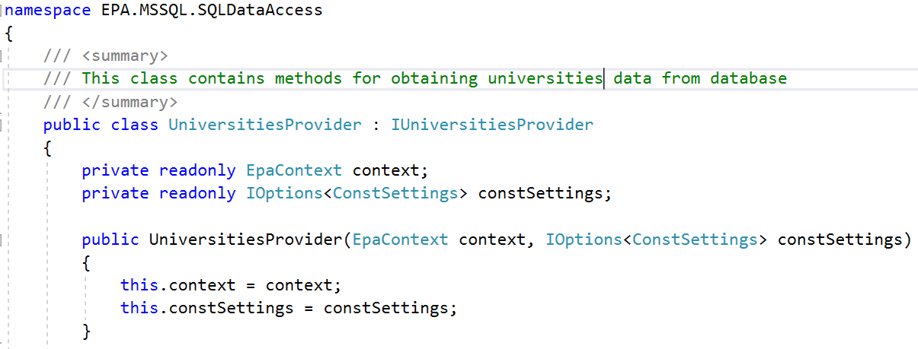
Class UniversitiesProvider

Slide 23
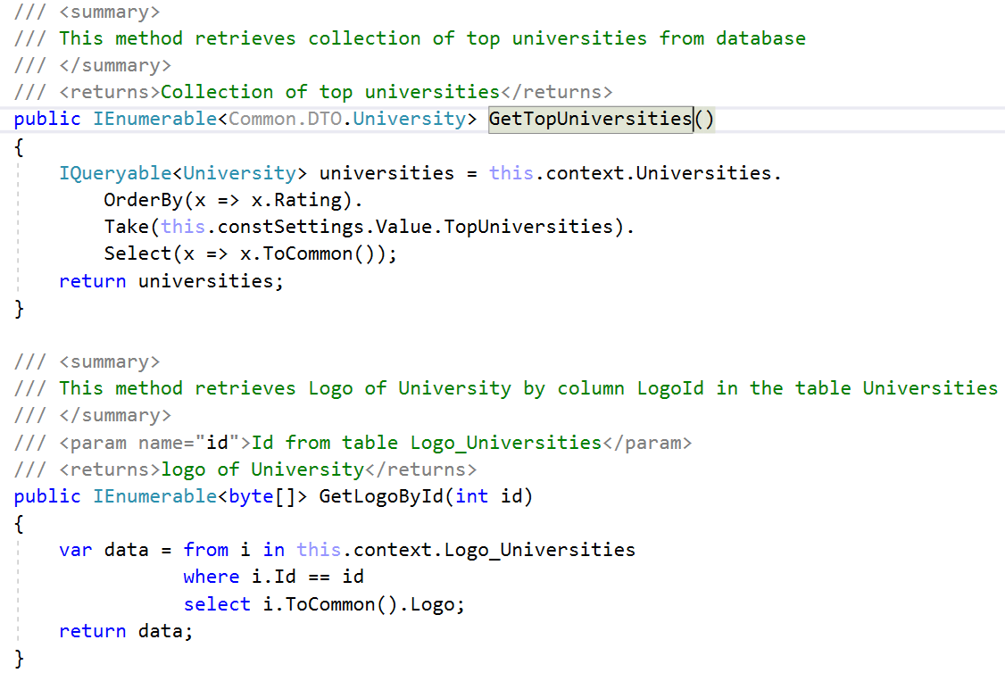

Slide 24
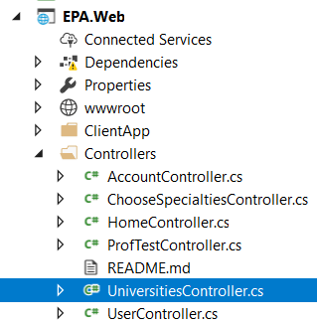
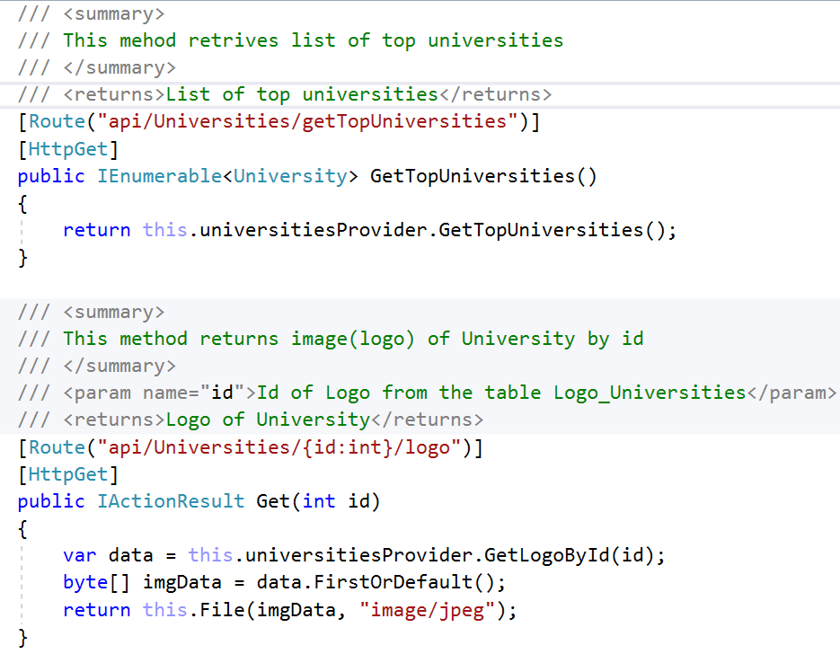

Slide 25
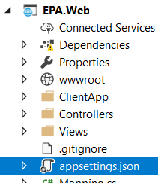
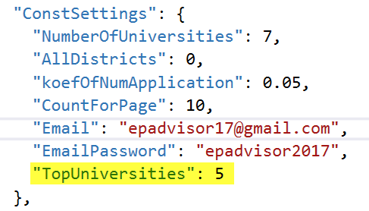
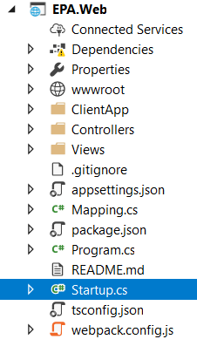
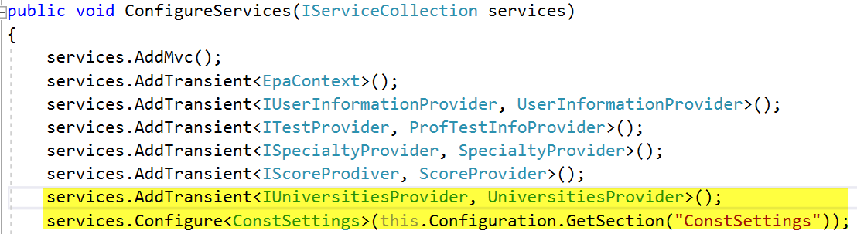
Configuration

Slide 26
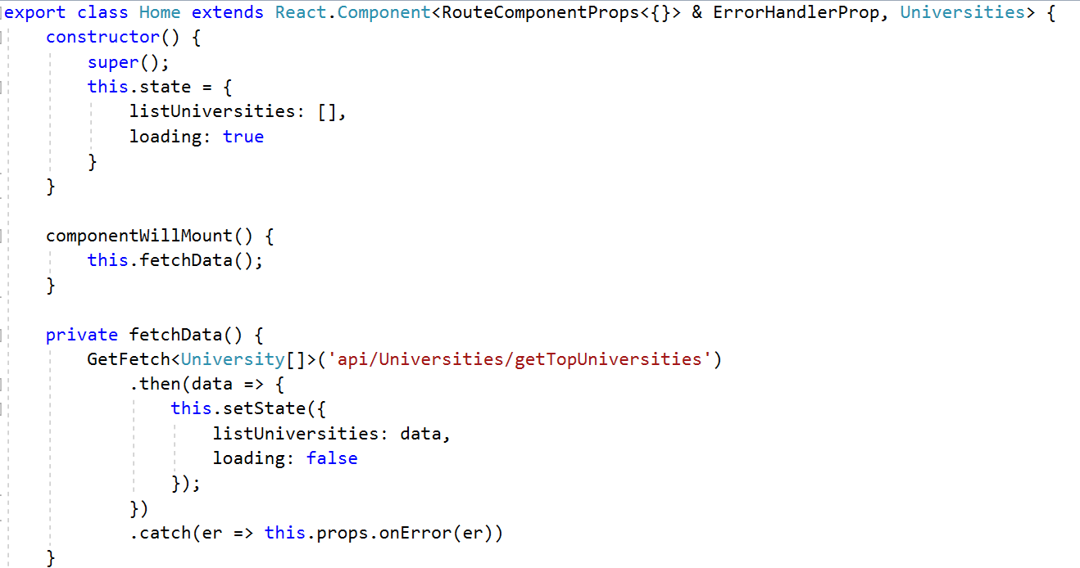
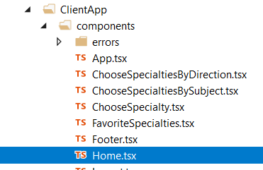
Home.tsx - Component of React

Slide 27
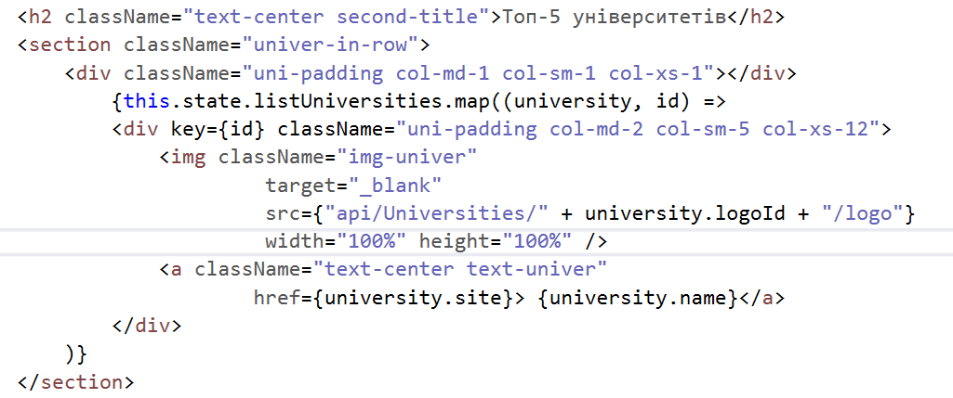
Home.tsx - Component of React

Slide 28
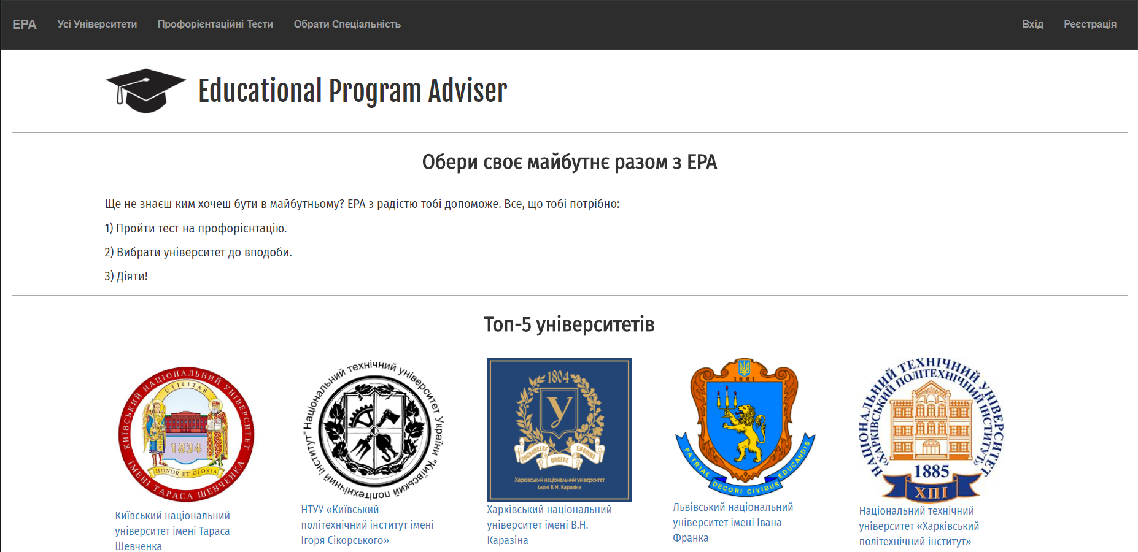
Home Page with 5 top universities

Slide 30
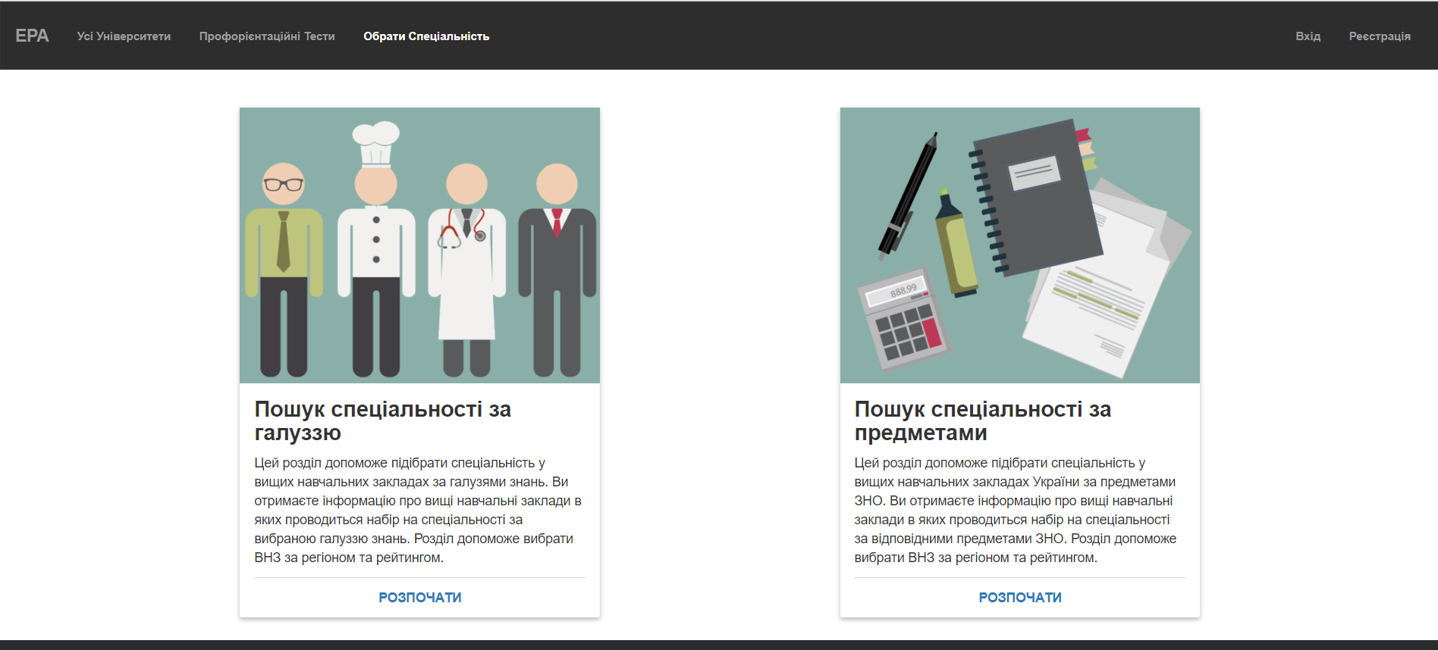
Choose specialty by direction and district
As a user I would like to find specialty by direction in a concrete district
in ETL download specialties, universities and information about them;
to make procedures for access on DB;
to make methods on API;
to make component on UI

Slide 31
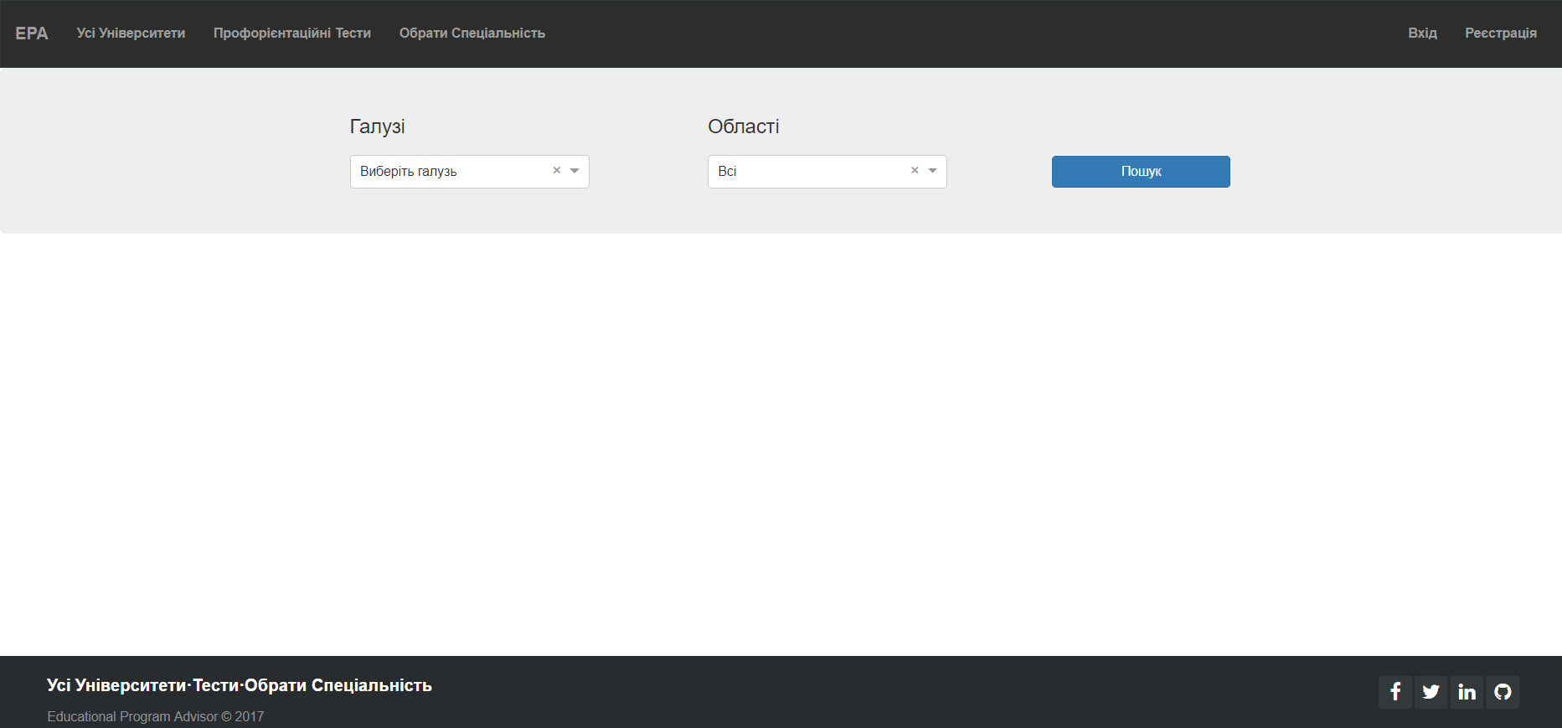

Slide 32
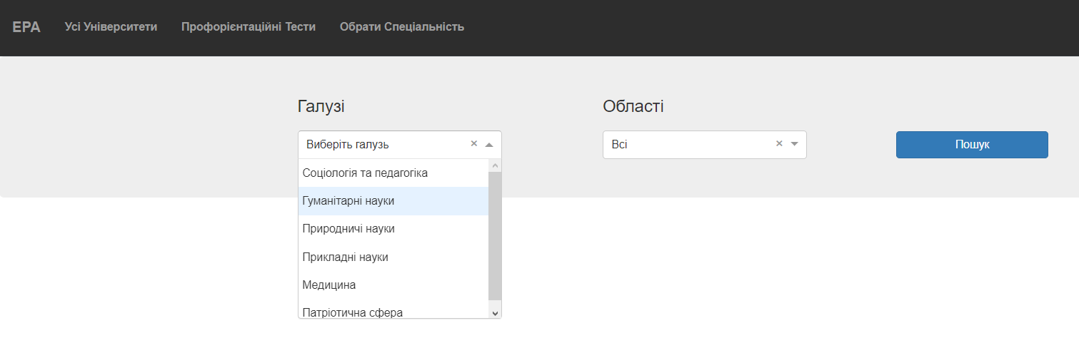
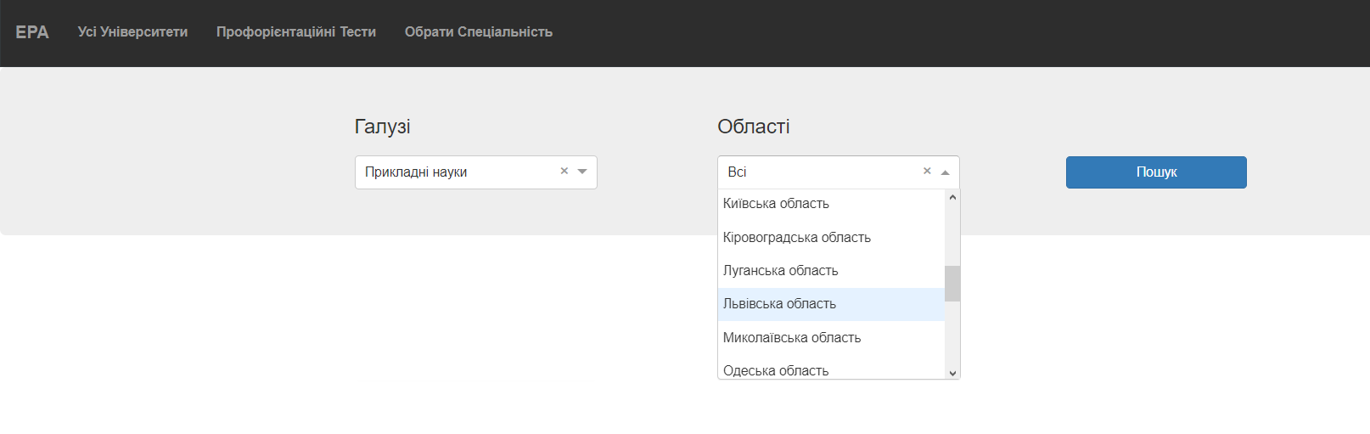

Slide 33
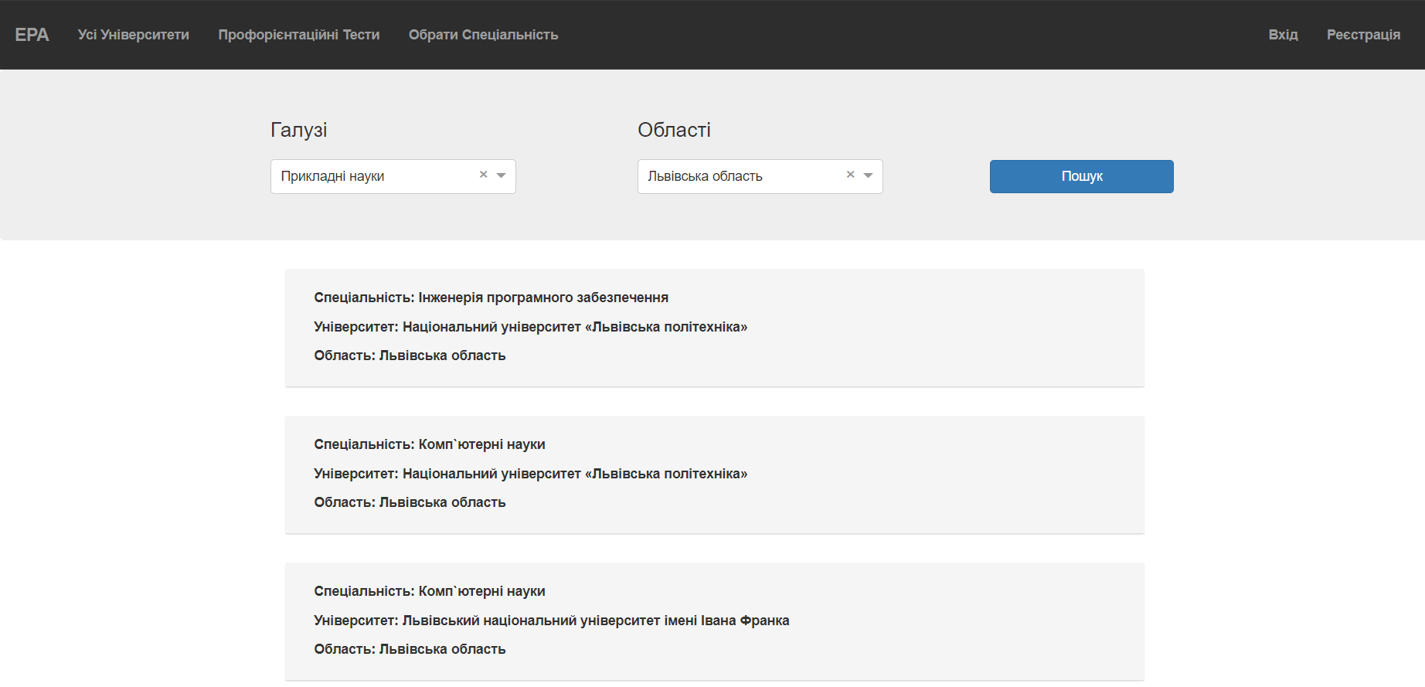

Slide 34
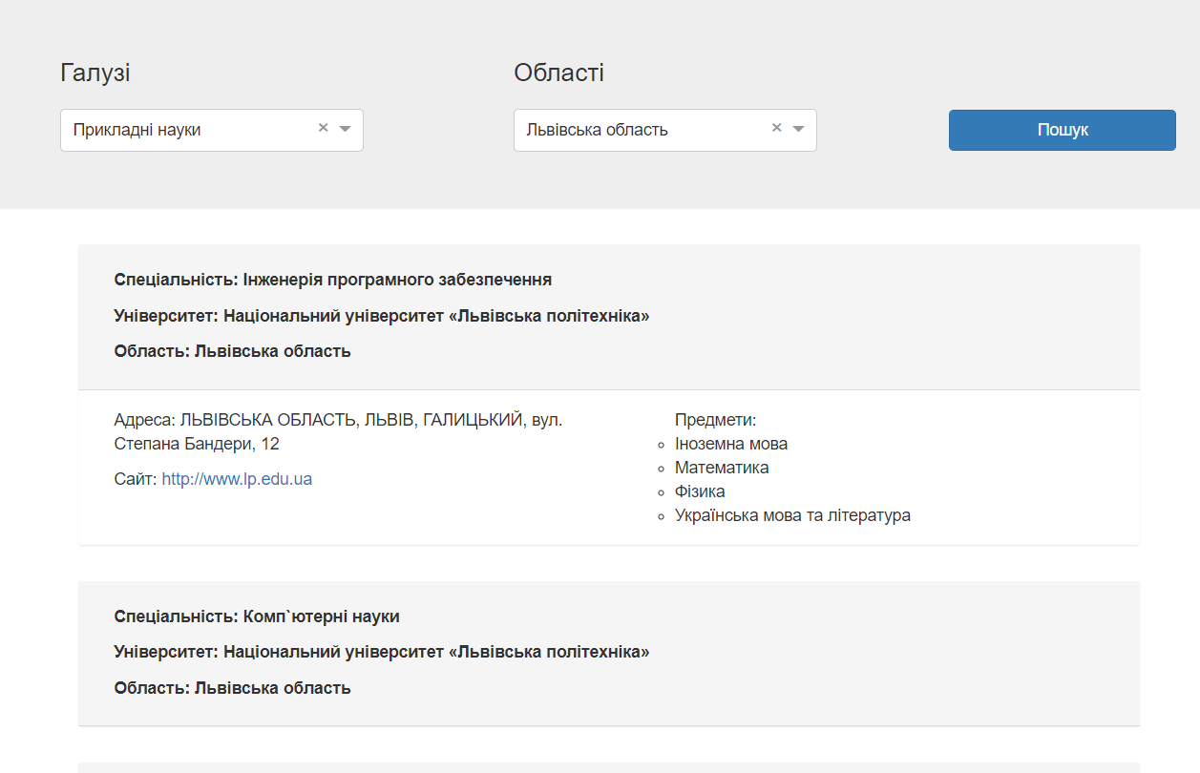

Slide 35
